Slide 1
Mood Disorders:
Mania,
Depression,
Dysthymia.
DR. HARI SANKAR MD (Hom)
DEPT. OF PRACTICE OF MEDICINE
SARADA KRISHNA HOMOEOPATHIC
MEDICAL COLLEGE, KK DIST

Slide 2
Manic Depressive Psychosis (MDP) is presently known as Mood disorders (MD). A persistent change in mood is the basic abnormality in this disorder. When the mood remains sad (depressed) the resulting clinical condition is called depression. It is called mania when the mood remains elevated and cheerful. The disorder usually runs an episodic course with recovery and recurrence. In between, lucid intervals occur in which the patient is normal. Mood disorders may be unipolar depression, or bipolar mood disorders (BPMD). In unipolar depression only depressive episodes occur but they occur consecutely atleast thrice. In BPMD both depressive and manic episodes occur.

Slide 3
Etiology
The etiological factors for mood disorders fall under two broad groups-biological and psychosocial. The important biological factors may be genetic, biochemical, endocrine or neuro-anatomical.
Genetic factors: The incidence of mood disorders is high among the close relatives of the patients. Children born to affected parents develop the disorders.
The central monoamines, residual sodium and melatonin are the more important biochemical factors implicated. Norepinephrine, serotonin and dopamine are the brain neurotransmitters involved. The concentration, turnover and postsynaptic receptor

Slide 4
Endocrine disorders such as Cushing’s syndrome, hypothyroidism and hyperparathyroidism are known to produce depression. The secretion of cortisol is high in depression due to hyperactivity of the hypothalamic-pituitary-adrenal axis.
Organic disorders like cerebral atherosclerosis, neurosyphilis, AIDS, Parkinson’s disease and frontal lobe injuries may produce depression.
Psychological and social factors are closely linked. The prominent psychosocial factors are recent stressful life events, obsessive and cyclothymic (mood swings) personality traits, loss of maternal affection during childhood, loss of loved objects, loneliness, helplessness, and cognitive distortions.

Slide 5
MANIA
CLINICAL FEATURES
• Elation of mood is the characteristic disturbance in mania. It is expansive. Generally, the manic patient appears well dressed, often in colorful clothing and is cheerful. He is entertaining and often highly interfering. He forms the focus of attention by his talk and jocularity. In the case of hypomania, the mood is one of euphoria with a generalized feeling of increased well-being.
• Thought/talk: The patient talks excessively and he is rich in ideas. The talk is often coherent, but may not be relevant. Since the rate of talk is high, too many
ideas may be crowded into the mind, giving rise to pressure of talk. Often, the ideas shift from topic to topic giving rise to “flight of ideas”.

Slide 6
• Disorders of perception such as illusions may be present during manic excitement. Hallucinations are rare in mania.
• Motor activity: Mania is associated with exuberant energy and overactivity. He may get-up very early in the morning and engage himself in various kinds of
unwanted activities. The actions are left incomplete.
• Other symptoms: These include increased sexual urge, extravagance, drug abuse and intoxication. Intelligence is well preserved. There is apparent
impairment of memory on account of rapid flight of attention. Insight and judgment are impaired. Insomnia is a regular feature.
Diagnosis: The diagnosis is based on the clinical features.

Slide 7
Features of mania
Elated, expansive mood
High motor activity
Richness of ideas
Flight of ideas
Jocularity
Grandiose delusions.
Treatment: Pharmacotherapy and electroconvulsive therapy (ECT) are employed in the treatment of mania.

Slide 8
Depression (Major Depression)
Depression may be a symptom, a syndrome or a disease entity (depressive illness). Several terms such as psychotic depression, endogenous depression, MDP depression, agitated depression, involutional melancholia or masked
depression are used to designate depressive disorder.
CLINICAL FEATURES
• Mood: The symptoms of depression are centered around the disturbance in mood. The mood is sad. The face appears gloomy with wrinkled forehead, drooping of the eyelids and sagging of the angles of the mouth.
They show no interest in pleasurable activities
(anhedonia)

Slide 9
• Thought and speech: The speech is slow, and the voice is low. Poverty of thinking and loss of self confidence are prominent symptoms. They are
pessimistic and they lack self-confidence. They may retain ideas or delusions of guilt, worthlessness and hopelessness.
• Disorders of perception: Auditory hallucinations of accusatory nature may occur.
Motor activity is retarded. The movements are slow. The patient tends to stoop while walking or sitting. Depressed patients become self-centered and prefer to be left undisturbed.
Their attention and concentration are impaired.
The insight and judgment may be impaired
Pseudodementia The sluggishness of mental activity and impairment of attention and concentration may give an apparent impression of dementia.
Somatic symptoms: Loss of appetite, loss of weight, constipation, loss of libido and late insomnia are vital symptoms of depression .

Slide 10
Diagnosis: Diagnosis of depression is made on the basis of clinical features.

Slide 11
Dysthymic Disorders
This used to be known as neurotic or reactive depression. This is considered as a variant of depression, mild in intensity, chronic in duration and without delusions or hallucinations. Somatic symptoms such as loss of weight, loss of appetite and loss of libido are not marked. Insomnia is early and sleep is fretful. The symptoms are worse in the evenings unlike as in the case of mood
disorders.
Treatment: This includes counselling, psychosocial therapy, and pharmacotherapy with antidepressants

Slide 12
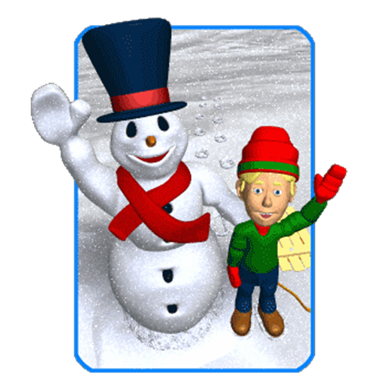
Any doubts??
Thank you..

